Slide 1
Team 5 Expedia Hotel Recommendations Ruchira Patil Ziqing Zhou

Slide 2
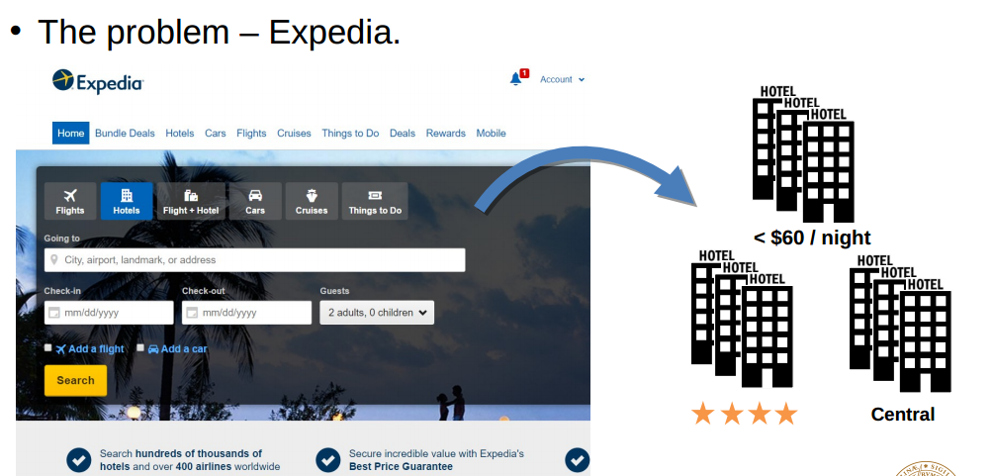
Use cases to be satisfied for hypothetical customers;
Which hotel type will an Expedia customer book?

Slide 3
Methodology (how/what do you propose to do);
Recommendation
Prediction
Descriptive Analysis and BI
Creating web dashboards
if time permits. time data pipeline

Slide 4
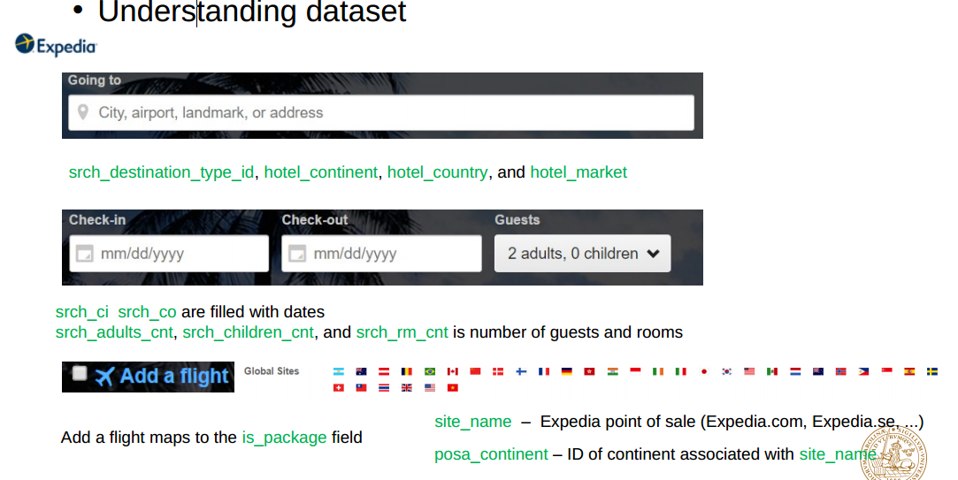
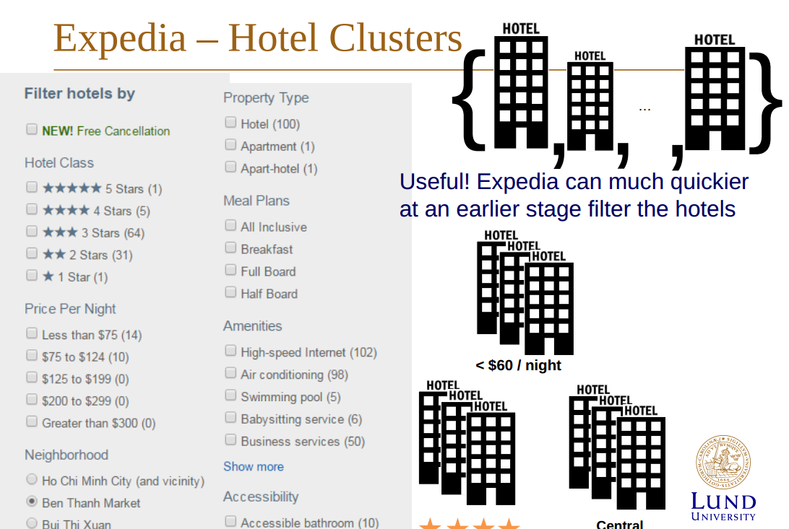
Data sources, enumerating the magnitude of the data that you will process;
Expedia – dataset(Kaggle) • 24 column in training(4.09GB) • 22 column in testing (no is_booking, no hotel_cluster)(424MB) • Most of the columns are integers or floats • Output hotel cluster ID integer range from 1-99

Slide 5
Milestones/sprints (approximately one week to ten days between each);
implementing

Slide 6
What will you program in Scala and where will your code repository be?
Spark mlib
Scala playframework to create BI dashboar

Slide 7
Acceptance criteria (how will I know that you have achieved what you set out to do?);
Data clean and process
Consuming apache spark mlib mapreduce and spark sql and
Calculating Rating Matrix
Successfully recommend different type of hotel according to tht different type of costumers.

Slide 8
Goals of the project (what do you expect to achieve and accomplish).
Our goal of this project is to predict the booking outcome (hotel cluster) for a user event, based on their search and other attributes associated with that user event.

